Slide 1
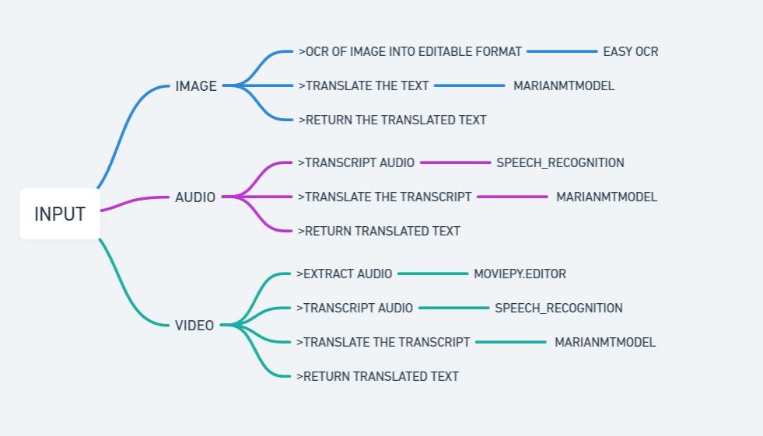
Methodology
5

Slide 2
MarianMT: A Neural Machine Translation Framework
MarianMT is an efficient, open-source Neural Machine Translation (NMT) framework. It's designed for high-performance translation tasks and is based on the popular Transformer architecture.
Helsinki-NLP: The Source of Pre-trained Models
Helsinki-NLP is a research group at the University of Helsinki specializing in Natural Language Processing. They released a large collection of pre-trained MarianMT models which are trained on massive multilingual datasets and cover various language pairs.
Once EasyOCR recognizes the Hindi text, we use the loaded Helsinki-NLP, which provides readily available pre-trained MarianMT model to translate it into English

Slide 3
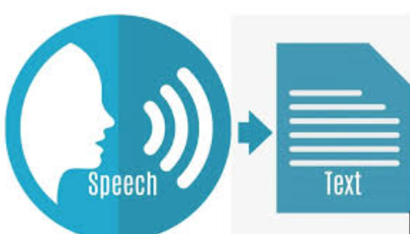
Google text to speech Api
Audio Input
Audio Preprocessing
Noise reduction
Feature extraction
Acoustic Model (not disclosed by google)
Language model (use of combination of transformer neural networks)
Decoding
Post-processing
Output : plain text or JSON

Slide 4
Results
Find audio and video input results at: https://colab.research.google.com/drive/1S0sXJJGmv8QZhFpqvCwJ5fT_i5WwuXJb?usp=sharing
For input image:

Slide 5
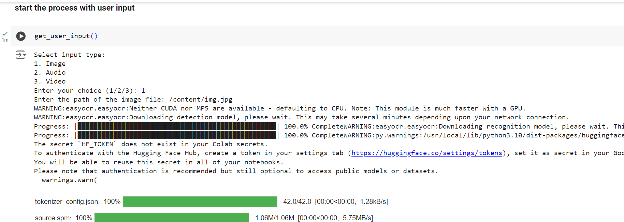
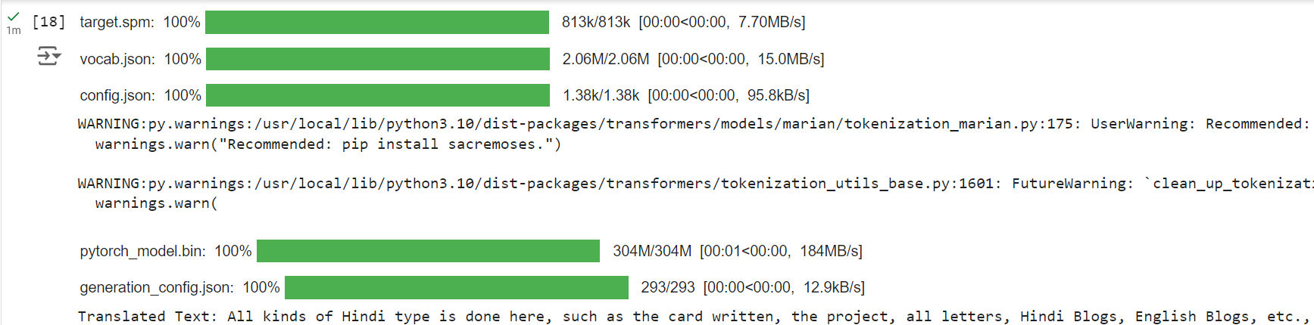

Slide 6
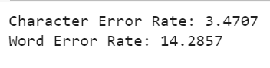
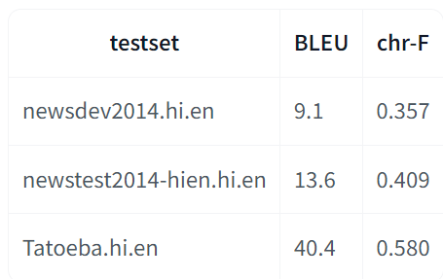
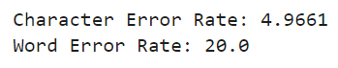
Evaluation metrics
https://colab.research.google.com/drive/1yRqU7d-gNlvvpTV5HNMk3yGzSixo-0sz?usp=sharing
OCR (Optical Character Recognition)
Word Error Rate (WER)
Character Error Rate (CER)
Machine Translation
BLEU (Bilingual Evaluation Understudy)
BertScore
Speech Recognition
Word Error Rate (WER)
Character Error Rate (CER)

Slide 7


Experiment 1 performed (Video input)
Extracted audio:

Slide 8
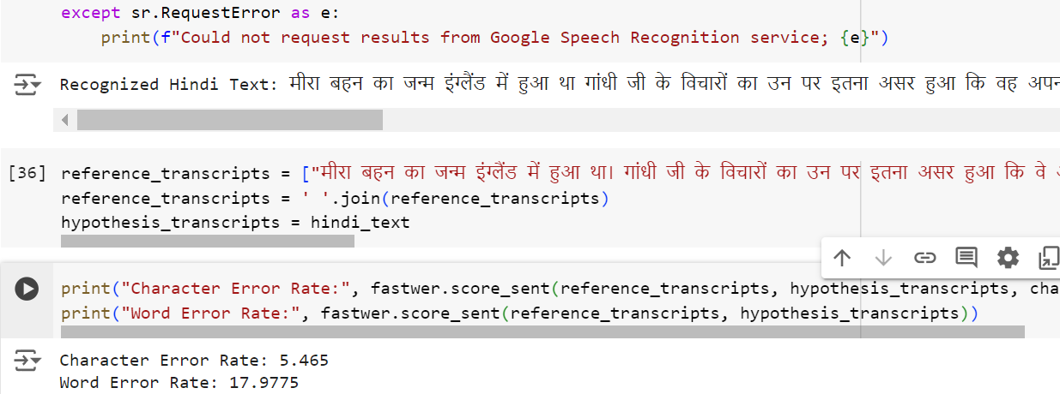
Experiment 1 performed (Audio Transcription)
Input audio:

Slide 9
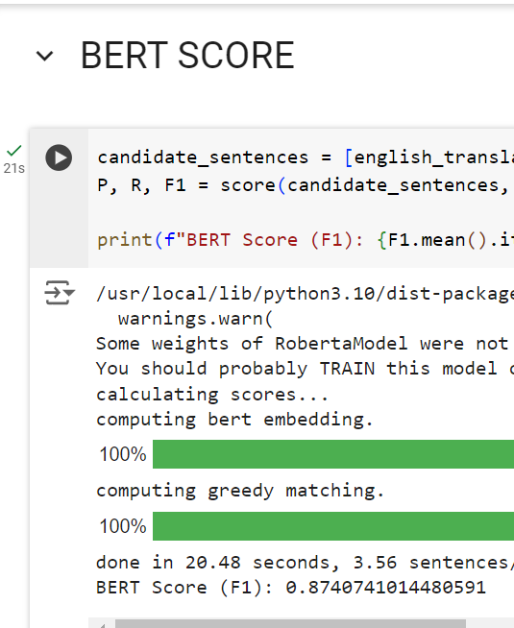
Experiment 1 performed (Translation)
HINDI TEXT: ‘मीरा बहन का जन्म इंग्लैंड में हुआ था। गांधी जी के विचारों का उन पर इतना असर हुआ कि वे अपना घर और अपने माता-पिता को छोड़कर भारत आ गईं और गांधी जी के साथ काम करने लगीं। आज़ादी के पाँच साल बाद उन्होंने उत्तर प्रदेश के एक पहाड़ी गाँव, गेंवली में गोपाल आश्रम की स्थापना की। उस आश्रम में मीरा बहन का बहुत सारा समय पालतू पशुओं की देखभाल में बीतता था लेकिन गेंवली गाँव के आसपास के जंगलों में बाघ जैसे खतरनाक जानवर भी रहते थे।’
reference : [“Mira sister was born in England.
Gandhiji's ideas had such an impact on her that she
left her home and parents and came to India and
started working with Gandhiji. Five years after
independence, she established Gopal Ashram in a hilly
village of Uttar Pradesh, Genveli. In that Ashram,
Mira sister spent a lot of time taking care of pets,
but dangerous animals like tigers also lived in the
forests around Genveli village.”]

Slide 10
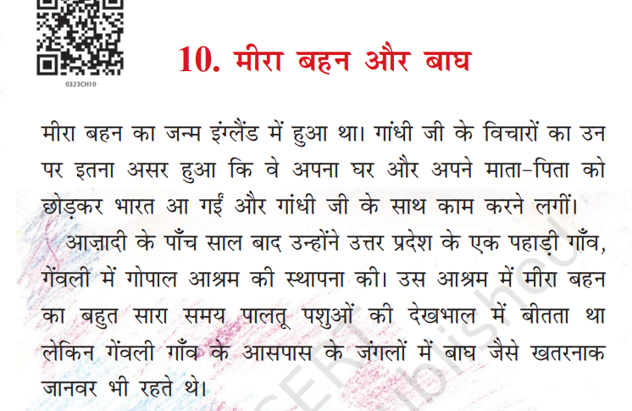
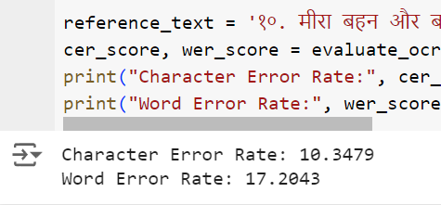
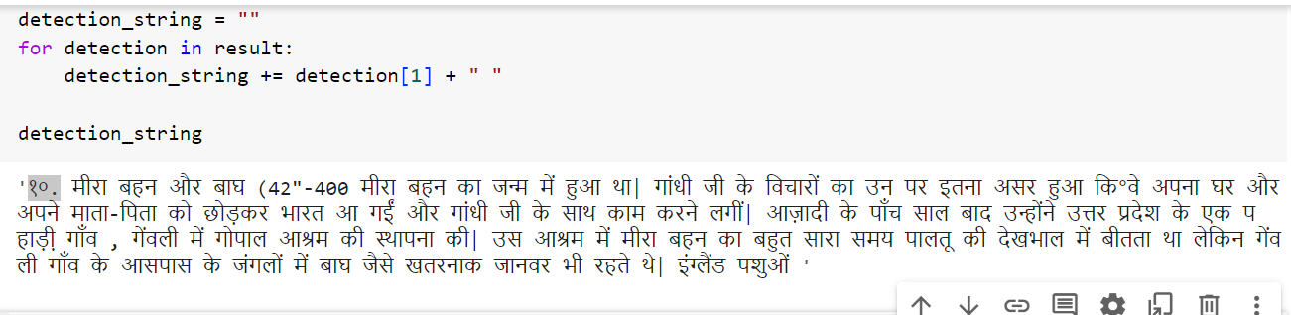
Experiment 1 performed (OCR)

Slide 11
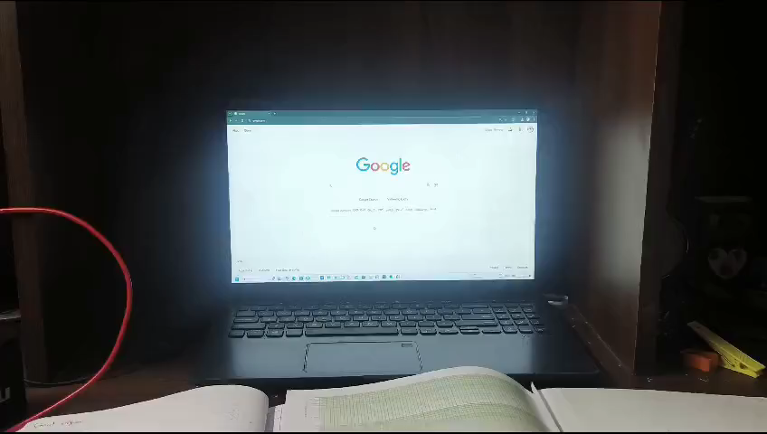
Experiment 2 performed (Video input)
Extracted audio:

Slide 12
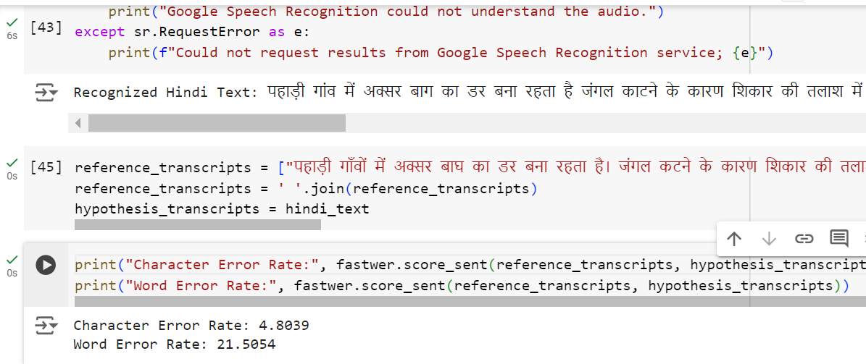
Experiment 2 performed (Audio Transcription)
Input audio:

Slide 13
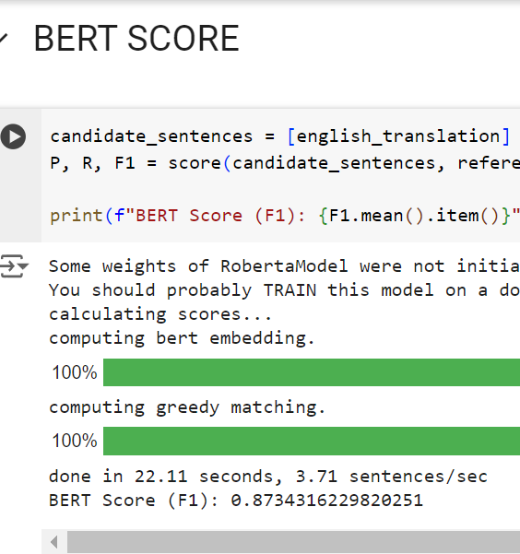
Experiment 2 performed (Translation)
HINDI TEXT: 'पहाड़ी गाँवों में अक्सर बाघ का डर बना रहता है। जंगल कटने के कारण शिकार की तलाश में बाघ कभी-कभी गाँव तक पहुँच जाता हे। गेंबली गाँव में एक बार यही हुआ। एक बाघ ने गाँव में घुसकर एक गाय को मार डाला। सुबह होते ही यह खबर पूरे गाँव में फैल गई। गाँव के लोग डरे कि यह बाघ कहीं फिर से आकर दूसरे पालतू जानवरों और किसी आदमी को ही अपना शिकार न बना ले। गाँव के लोग गोपाल आश्रम गए और उन लोगों ने मीरा बहन को अपनी चिंता बताई।'
reference : [“In hilly villages, there is often a fear of tigers. Due to deforestation, tigers sometimes reach the village in search of prey. Once, this happened in the village of Gembali. A tiger entered the village and killed a cow. As soon as morning broke, this news spread throughout the village. The villagers were afraid that the tiger might come again and prey on other domestic animals or a human. The villagers went to Gopal Ashram and told Mira Bahen about their worries.”]

Slide 14
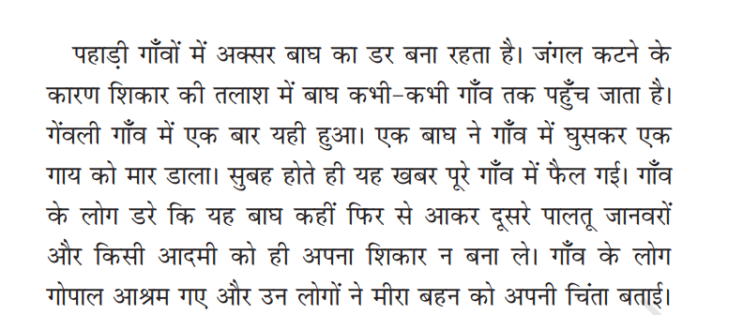
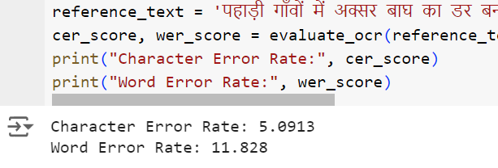
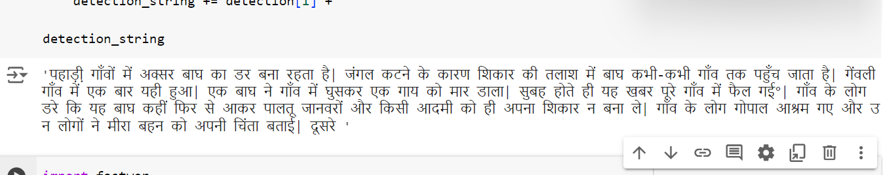
Experiment 2 performed (OCR)

Slide 15
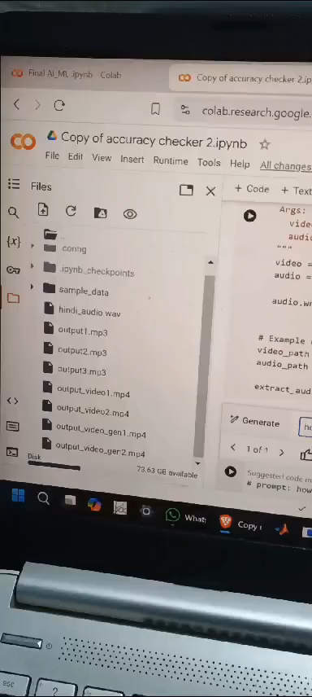
Experiment 3 performed (Video input)
Extracted audio:

Slide 16
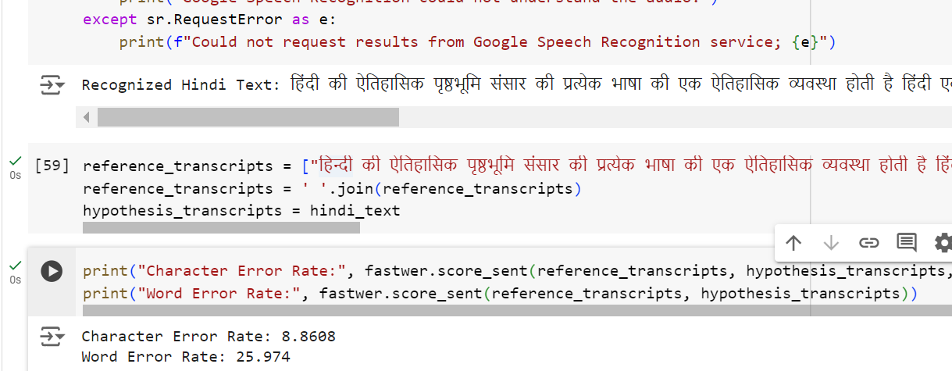
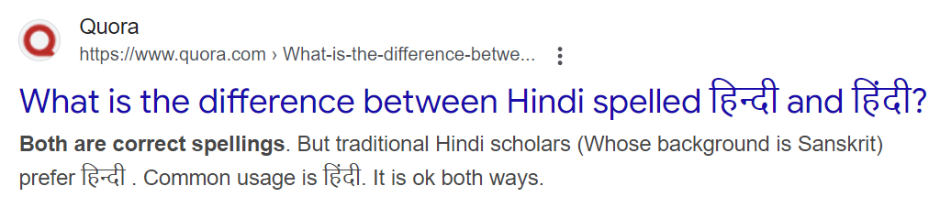
Experiment 3 performed (Audio Transcription)
Input audio:

Slide 17
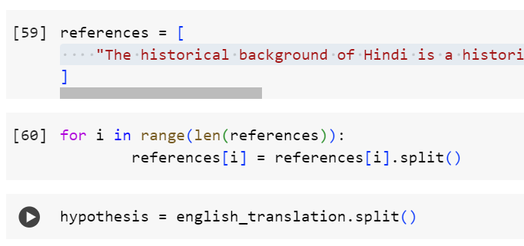
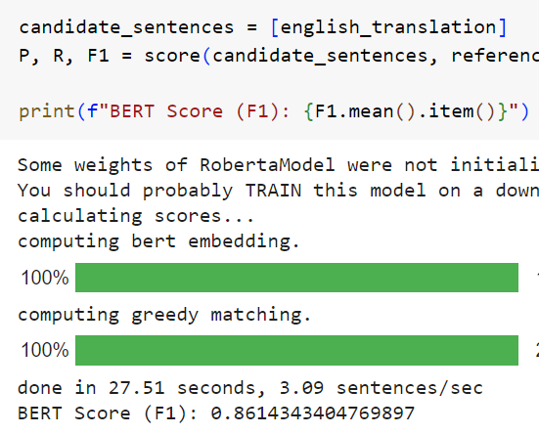
Experiment 3 performed (Translation)
HINDI TEXT: 'हिन्दी की ऐतिहासिक पृष्ठभूमि संसार की प्रत्येक भाषा की एक ऐतिहासिक व्यवस्था होती है। हिन्दी एक भारतीय आर्यभाषा। ‘हिन्दी’ शब्द का मौलिक अर्थ है- हिन्दी का अर्थ भारतीय। भाषा के अर्थ में हिन्दी का प्रयोग फारसी और अरबी ने किया। पंडित रामनरेश त्रिपाठी के अनुसार, इस्लामी मुग़ल काल से ही भारत की हिन्दी कहलाने लगी थी। इतना स्पष्ट है कि कालान्तर में हिन्द देश के निवासियों को ‘हिन्दुस्तानी’ और उनकी भाषा को ‘हिन्दी’ कहा जाने लगा।'
reference = ["Hindi's historical background represents a historical system for every language in the world. Hindi is an Indian Indo-Aryan language. The basic meaning of the word 'Hindi' is that it signifies Indian. Hindi was used in the sense of language by Persian and Arabic. According to Pandit Ramnarayan Tripathi, India began to be called Hindi from the Islamic Mughal era. It is clear that over time, the residents of Hind Desh began to be called 'Hindustani' and their language 'Hindi”]

Slide 18
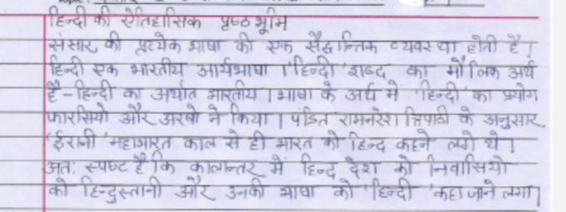
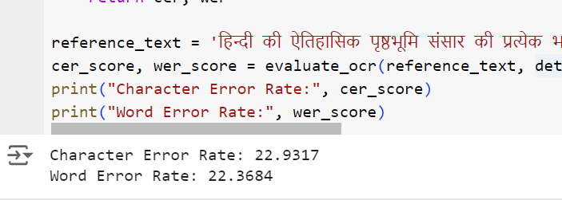
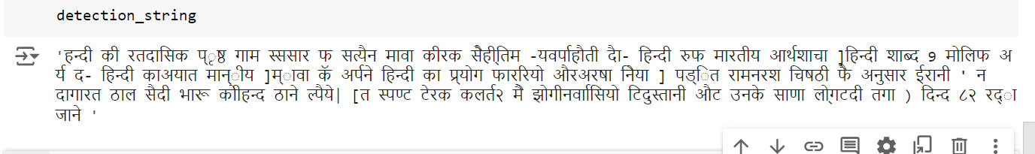
Experiment 3 performed (OCR)

Slide 19
Conclusion
We successfully developed a multi-modal processing system capable of handling images, audio, and video inputs
The system simplifies access to Hindi textual content, making it accessible to a broader audience.
This project showcases the power of integrating multiple AI technologies to address real-world challenges and open new possibilities for cross-lingual communication.
Future Enhancements
Expand language support for other regional languages and integrate additional translation models.
Improve the system’s real-time processing capabilities for faster and more accurate translations.
Do summarization of the processed text.
Real time subtitle generation

Slide 20
References
[1] P. Gupta and B. K. Joshi, "Natural Language Processing based Refining Hindi to English Machine Translation," 2022 International Conference on Applied Artificial Intelligence and Computing (ICAAIC), Salem, India, 2022, pp. 849-854.
[2] A. D et al., "Image Text Detection and Documentation Using OCR," 2024 International Conference on Smart Systems for Electrical, Electronics, Communication and Computer Engineering (ICSSEECC), Coimbatore, India, 2024, pp. 410-414
[3] D. R. Vedhaviyassh, R. Sudhan, G. Saranya, M. Safa and D. Arun, "Comparative Analysis of EasyOCR and TesseractOCR for Automatic License Plate Recognition using Deep Learning Algorithm," 2022 6th International Conference on Electronics, Communication and Aerospace Technology, Coimbatore, India, 2022, pp. 966-971
[4] Vishal Jayaswal, Sharma Ji, Ashish Kumar, Varun Kumar, Ayushi Prakash, "OCR Based Deep Learning Approach for Image Captioning", 2024 IEEE International Conference on Computing, Power and Communication Technologies (IC2PCT), vol.5, pp.239-244, 2024.
[5] Alief Dewana Iriawan, Andi Sunyoto, "Automatic License Plate Recognition System in Indonesia Using YOLOv8 and EasyOCR Algorithm", 2023 6th International Conference on Information and Communications Technology (ICOIACT), pp.384-388, 2023.

